Slide 1

INTERNSHIP
EVALUATION
Company
Shiryam Technologies
Project Supervisor:
Dr.Mayur Parate
Submitted By:
Katikala Bhanu Prathap
BT18ECE050

Slide 2

About Company
Shiryam Technologies provides custom software development services to individual clients, start-ups, medium businesses, and large enterprises. Being fully equipped with the latest technologies, Shiryam Technologies deliver futuristic software solutions to clients globally.
Products Developed:
FHM,L'OFFICIEL,CJ DARCEL,FHM STORE,SALT.PE

Slide 3
About My Role
I Have worked as Software Engineer Intern(Frontend) From 3rd June to 10th December.
My day to day responsibilities included developing the User Interfaces and the new features using the React,Redux,Javascript and other frontend Technologies.Also I was communicating with the client to get the feedback and work on improving the features.
The Design or mocks are given to us by clients either in figma or adobe xd.
Worked on the Bug fixes and written the test cases for components created.

Slide 4


Technology Stack
Programming language used is javascript for frontend and python for backend and the library which we are using is React.
Alongside with React we also used Redux,Material UI,Redux Saga For side effects like api consuming.
At the backend the technology stack used was python,flask,postgresql,aws.
For database we used sqlalchemy as orm to simplify the crud operations.

Slide 5
A Brief About React,Redux and Material ui
React-A JavaScript library for building user interfaces.
Declarative,Component-Based and Learn Once, Write Anywhere
Redux-A Predictable State Container for JS Apps
Predictable,Centralized,Debuggable and Flexible
Material UI-Extensive library of React components, ready for production

Slide 6
Minor Projects
I was given a task where using the mocks as reference I need to create a web page for a magazine website.
Another task where I was asked to create a website from mocks basically a CMS Website.
After I worked on the payment Gateway(Razorpay) for a influencer website.It was a challenging task as I was very new to it and I have referred to blogs to know and completed the task and now it is live and accepting the payments.

Slide 7


Slide 8
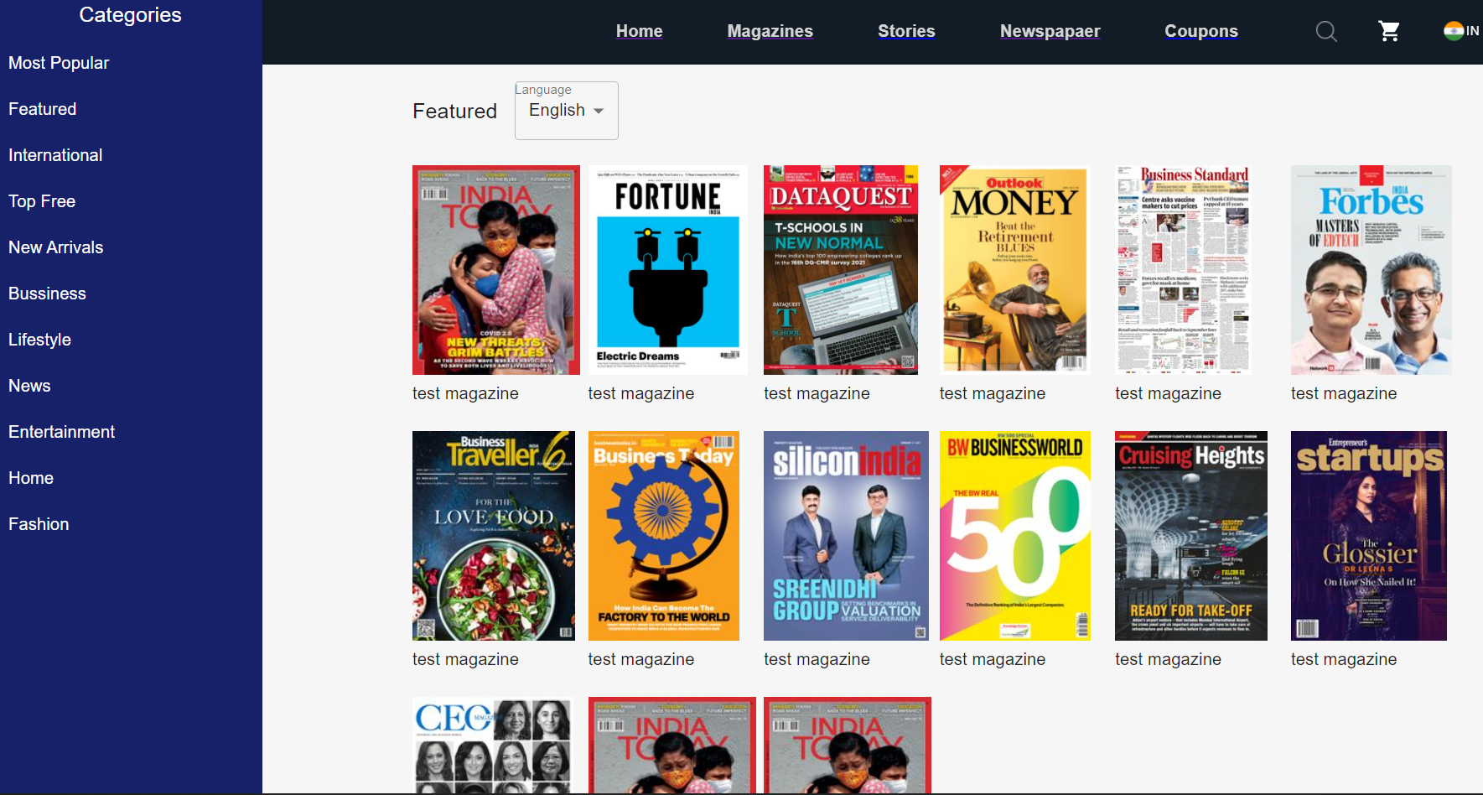
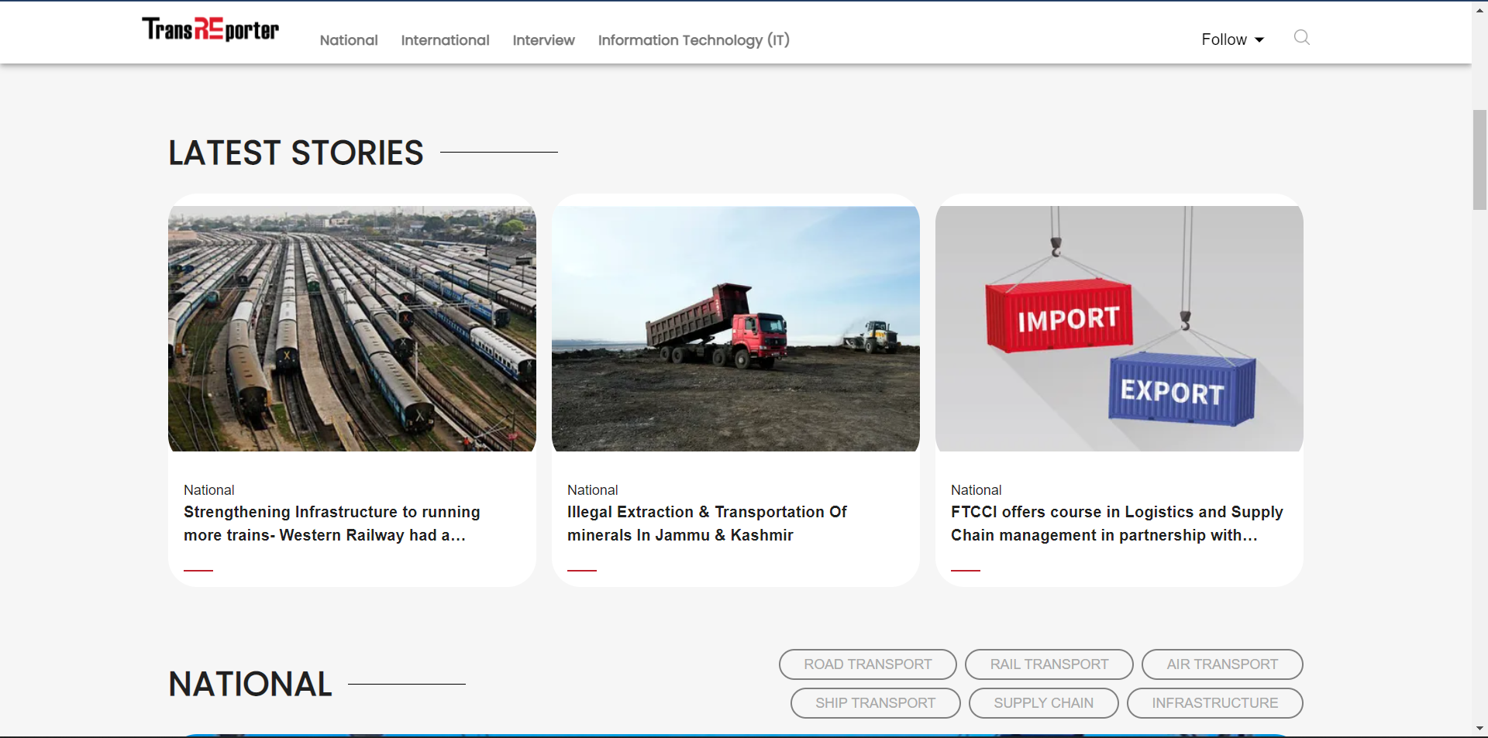
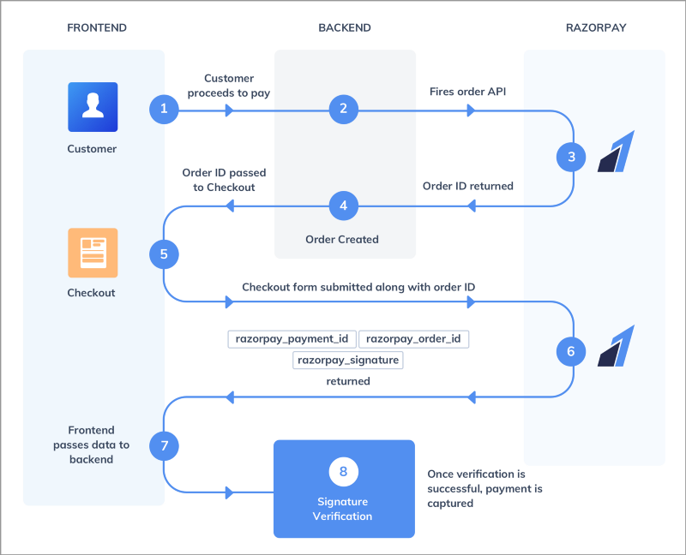
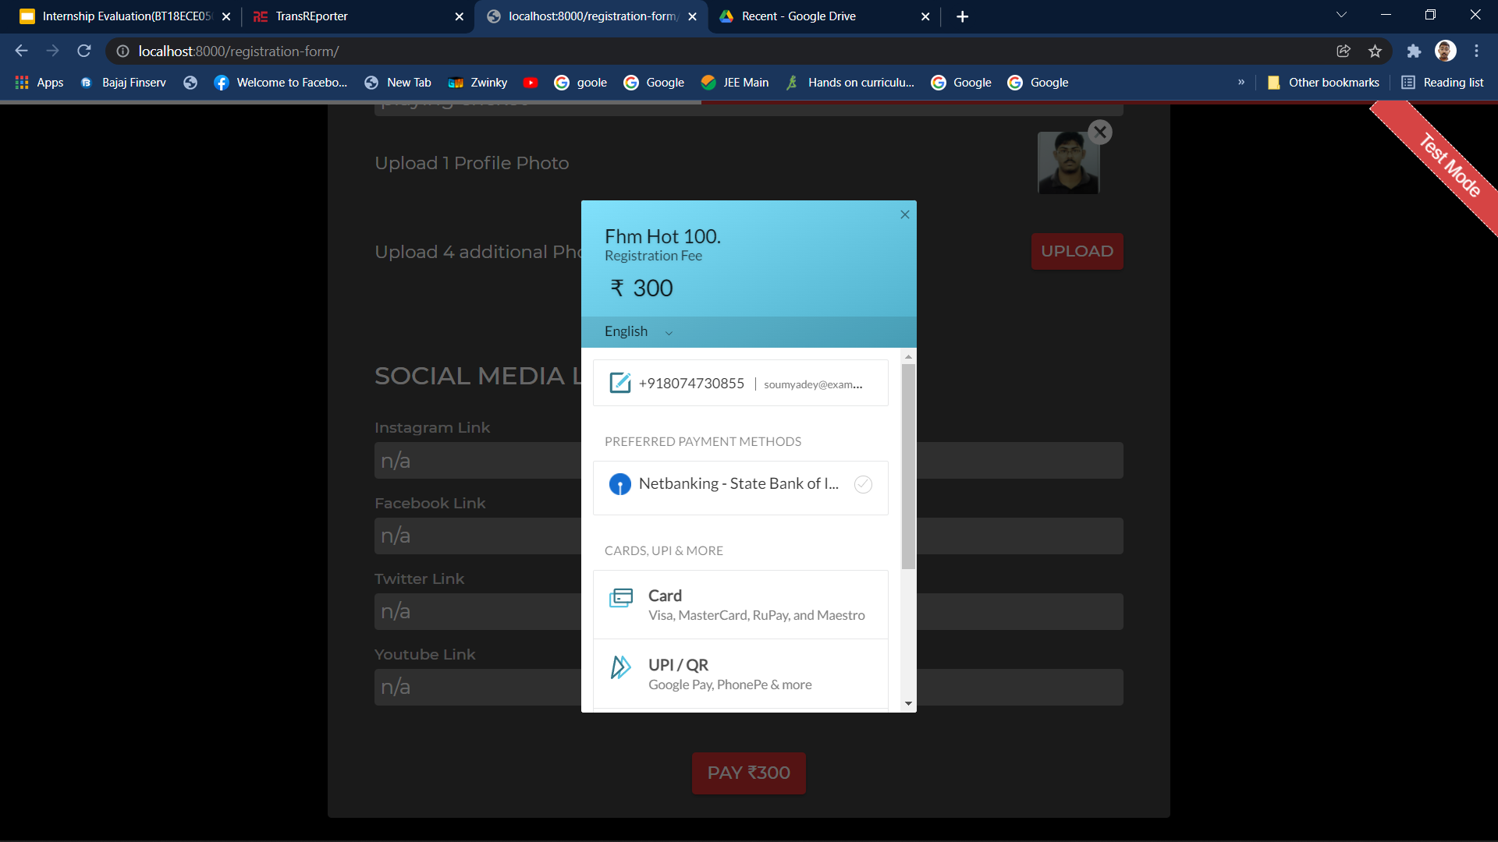

Slide 9
Major Project(SALT.PE)
Aug to Dec 4 months I was Working on A major project named SALT related to the Borderless Banking.
We have got the mocks from client in figma and started to create the UI and features and It took us 2 months to create the signup,onboarding section of the website and took feedback from client and improved the UI and modified few features.
https://app.salt.pe/
https://saltpe-stag.netlify.app/

Slide 11
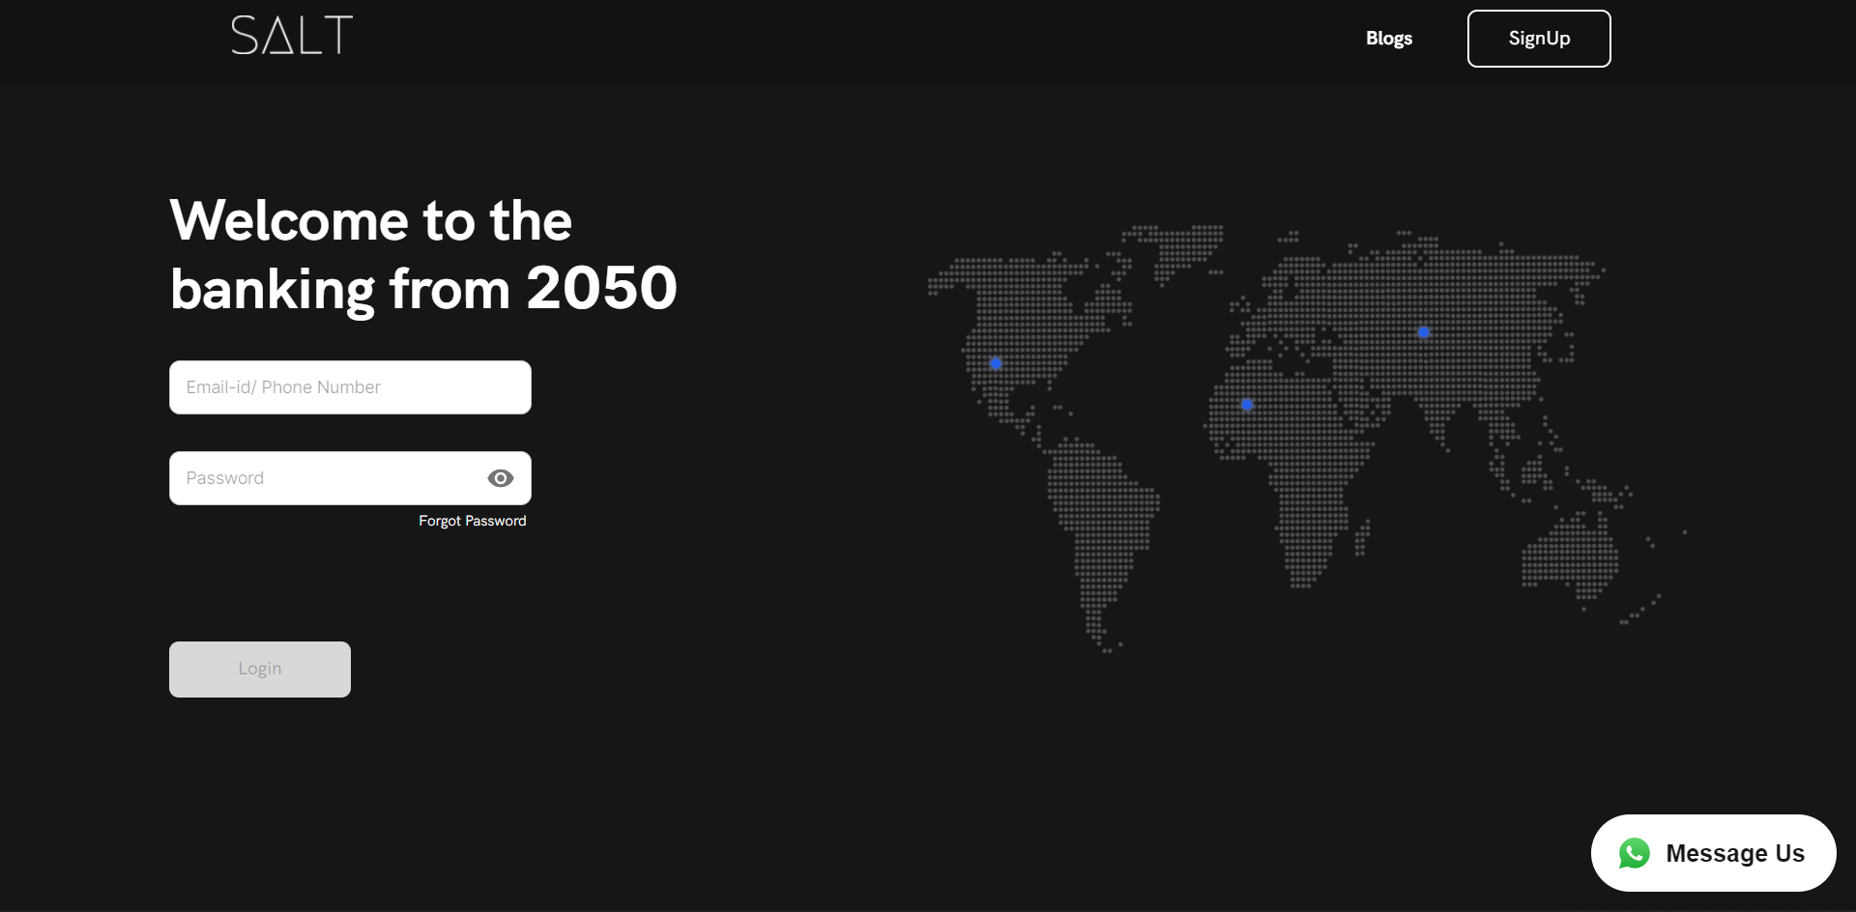
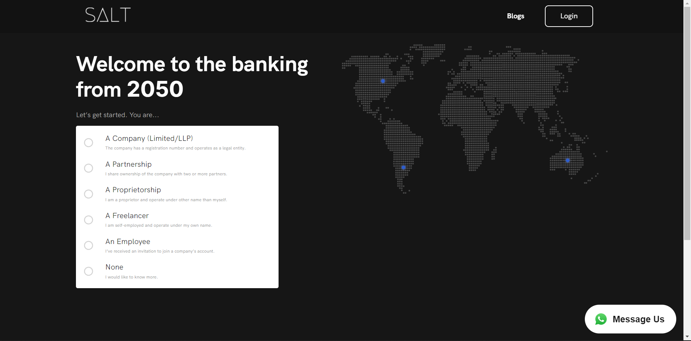
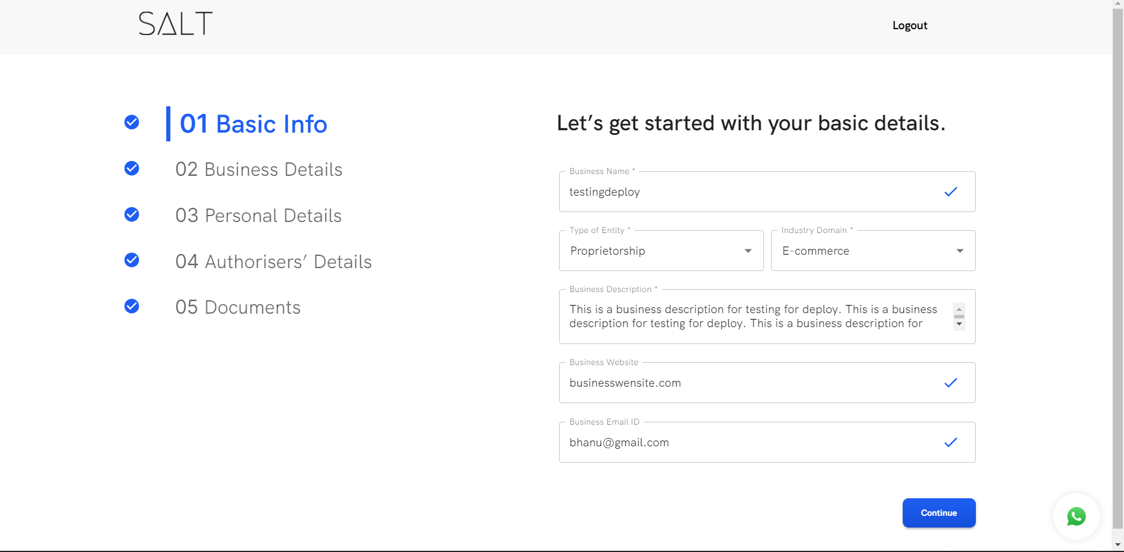
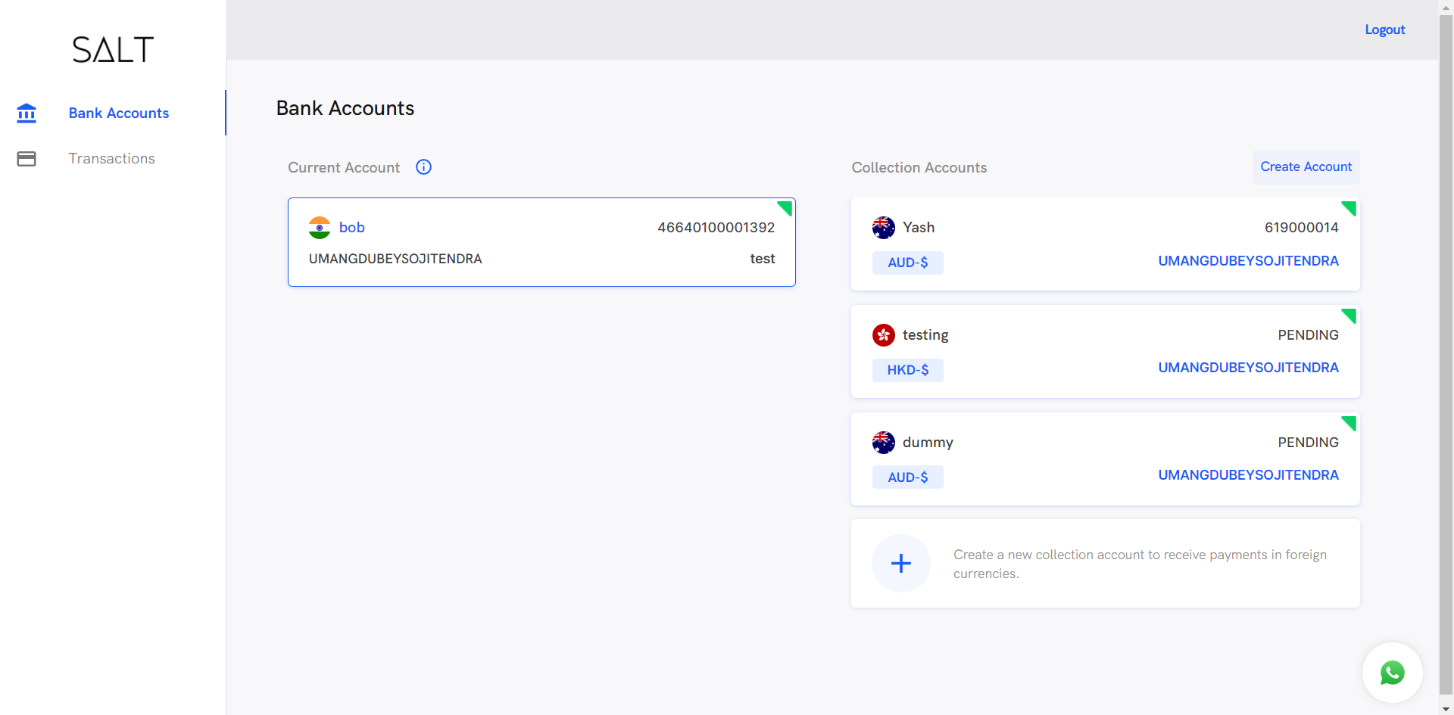

Slide 12
What I have learned from Internship
Team Work (Scrum and Team meetings Everyday)
Time Management
Improving the communication skills
Learned various front end technologies
Test Cases
Most Importantly because of internship I understood How software products are delivered from development to deployment.

Slide 13
Important Links
https://saltpe-stag.netlify.app/accounts/
https://app.salt.pe/
https://drive.google.com/file/d/1jHpIZ9AdeTKL5NzVBL-0H0ZtCmh9KkVw/view?usp=sharing

Slide 14
Thank You

